Slide 1
Project Name : Port Address Translation-PAT
WellCome

Slide 2
Subject : Network LAB -318
Submitted To : Submitted By :
MD SAMRAT ALI ABU KAWSER Md. Sultan Alauddin
Lecturer & Coordinator(Evening) ID : 1915002529
Batch : 50th (Eve.)
City University City campus

Slide 3
Port Address Translation (PAT)
PAT Scenario :
In this topic, we will learn how to configure and verify PAT. It includes a Packet Tracer activity to test your skills and knowledge. There are two ways to configure PAT, depending on how the ISP allocates public IPv4 addresses. In the first instance, the ISP allocates a single public IPv4 address that is required for the organization to connect to the ISP and in the other, it allocates more than one public IPv4 address to the organization.

Slide 4
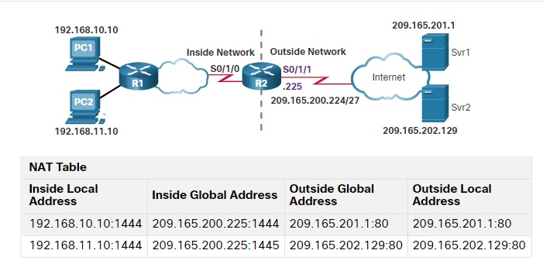
Both methods will be demonstrated using the scenario shown in the figure.

Slide 5
Configure PAT to Use a Single IPv4 Address
To configure PAT to use a single IPv4 address, simply add the keyword overload to the ip nat inside source command. The rest of the configuration is the similar to static and dynamic NAT configuration except that with PAT, multiple hosts can use the same public IPv4 address to access the internet.
In the example, all hosts from network 192.168.0.0/16 (matching ACL 1) that send traffic through router R2 to the internet will be translated to IPv4 address 209.165.200.225 (IPv4 address of interface S0/1/1). The traffic flows will be identified by port numbers in the NAT table because the overload keyword is configured.

Slide 6
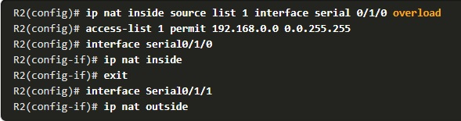
PAT Configure Command

Slide 7
Configure PAT to Use an Address Pool
An ISP may allocate more than one public IPv4 address to an organization. In this scenario the organization can configure PAT to use a pool of IPv4 public addresses for translation.
If a site has been issued more than one public IPv4 address, these addresses can be part of a pool that is used by PAT. The small pool of addresses is shared among a larger number of devices, with multiple hosts using the same public IPv4 address to access the internet. To configure PAT for a dynamic NAT address pool, simply add the keyword overload to the ip nat inside source command.

Slide 8
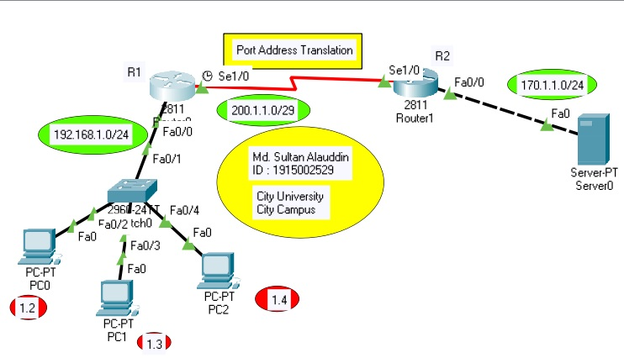
The topology for this scenario in the figure for your convenience

Slide 9
In the example, NAT pool sultan is bound to an ACL to permit 192.168.1.0/24 to be translated. These hosts can share an IPv4 address from the pool because PAT is enabled with the keyword overload
R1(config)#ip nat pool sultan 200.1.1.3 200.1.1.3 netmask 255.255.255.248
R1(config)#access-list 1 permit 192.168.1.0 0.0.0.255
R1(config)#ip nat inside source list 1 pool sultan overload
R1(config)#exit

Slide 10
Analyze PAT - PC to Server
The process of NAT overload is the same whether a pool of addresses is used, or a single address is used. In this figure, PAT is configured to use a single public IPv4 address, instead of a pool of addresses.PC1 wants to communicate with the web server, Svr1. At the same time another client, PC2and PC3 wants to establish a similar session with the web server. Both PC1 PC2 and PC3 are configured with private IPv4 addresses, with R1 enabled for PAT.

Slide 11

NAT Table

Slide 12
Verify PAT
The same commands used to verify static and dynamic NAT are used to verify PAT, as shown in the example output. The show ip nat translations command displays the translations from three different hosts to different web servers. Notice that two different inside hosts are allocated the same IPv4 address of 200.1.1.3(inside global address). The source port numbers in the NAT table differentiate the two transactions.

Slide 13
Reference by : cisco online virtual class room (https://www.netacad.com/)
https://contenthub.netacad.com/ensa/6.6.1
And Md. Sultan alauddin (Personal) - Github account (https://github.com/Sultan-Alauddin )
Thank You

